Slide 1

SharePoint Online and PowerShell

Slide 2



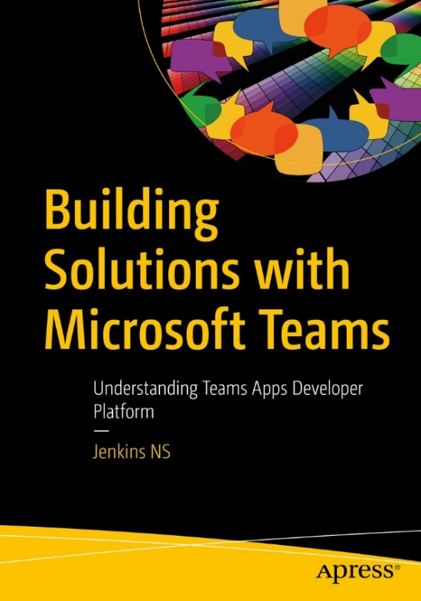








Jenkins NS
Modern Workplace Solution Architect | Consultant
18+ Years of experience
Power Platform, Microsoft Teams, and SPFx Specialist
International Speaker | Author | Trainer
SPS/M365 Bangalore Organizer
aOS Ambassador
SharePoint-er Since 2005!
jenkinsns@gmail.com
in/jenkinsns
@jenkinsns
http://www.jenkinsblogs.com
https://www.youtube.com/user/jenkinsns

Slide 3

Agenda
SharePoint Online & PowerShell
Introduction
Walk through to Modern SharePoint
SharePoint online PowerShell (SPO)
PnP PowerShell (SharePoint Patterns and Practices)

Slide 4
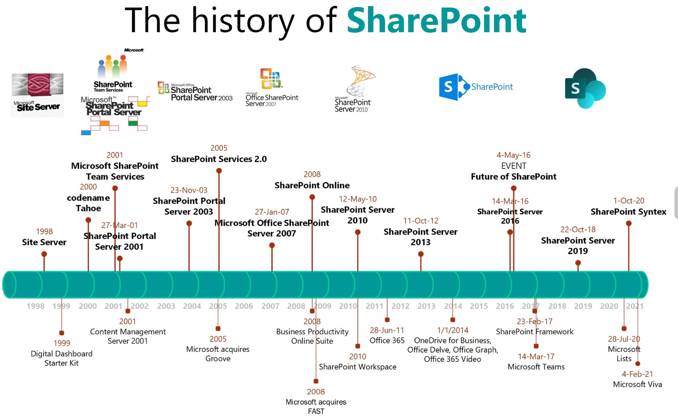

Slide 5
App Studio
Scripting On-Premises
You must have access to the underlying physical or virtual servers
The script must run on the server itself
You must be logged in with a high level of permissions on the server
You must set the execution policy to allow scripts to run
Your scripts may need to be signed if the system administrator or organizational policy requires it
You need to have access to the SharePoint PowerShell Snap-In and include it in your scripts
You must have a permission level in SharePoint that is high enough to accomplish the tasks you are attempting in your script code (this is also true in SharePoint Online)

Slide 6
App Studio
Scripting Online
We have no access to the underlying servers
The good news is we can run from any computer with the right software installed and an Internet connection
No special policy settings are necessary
All we need are Office 365 credentials with the appropriate permissions
It’s obvious but since we are logging in with our O365 credentials, we need to make sure that they have permission to complete the tasks that we are attempting with our scripts
We can consume the same SharePoint client libraries used by .NET and JavaScript
https://docs.microsoft.com/en-us/powershell/sharepoint/?view=sharepoint-ps

Slide 7
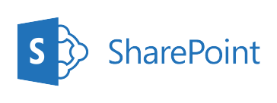

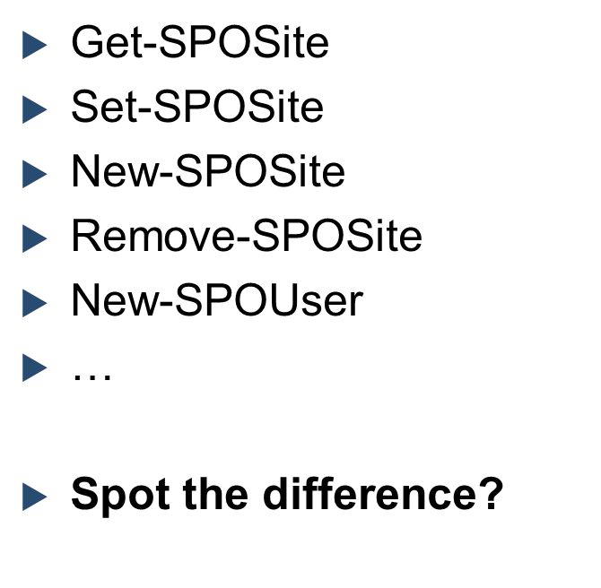
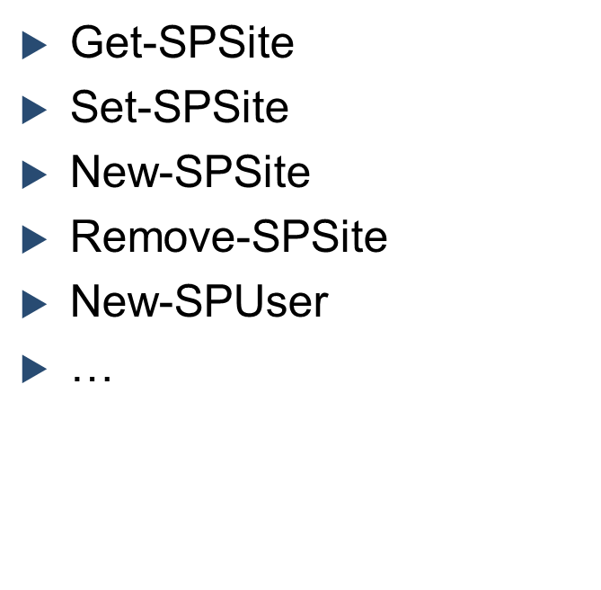
App Studio
Microsoft 365 vs. On Premises Cmdlets

Slide 8

App Studio
SharePoint online PowerShell (SPO) - cmdlets
Microsoft 365 Cmdlets for administrative tasks
Creating sites
Removing sites
Adding users
Creating groups
Hub sites
Etc.
Others required CSOM
https://docs.microsoft.com/en-us/powershell/module/sharepoint-online/?view=sharepoint-ps

Slide 9

App Studio
PnP PowerShell (SharePoint Patterns and Practices) - cmdlets
OfficeDevPnP is working on Microsoft 365 Cmdlets and rest for administrative tasks
PnP Cmdlets to manage artifacts in sites
Lists
Views
Fields
Upload files
Etc.
https://docs.microsoft.com/en-us/powershell/module/sharepoint-pnp/get-pnpaaduser?view=sharepoint-ps

Slide 10

App Studio
What is OfficeDevPnP?
A Microsoft-sponsored Community Project
Note: “sponsored”, not “supported”, it’s all open source, available on GitHub
Originally formed by a group of consultants working on the transformation of development practices from SharePoint On-Premises to SharePoint Online
Transforming SharePoint full Trust Code Solutions to the add-in model
An open-source community effort with both internal (Microsoft) and external contributors.
Not directly linked with the official Patterns and Practices team at Microsoft
Everyone involved is a volunteer, they all have their day jobs.

Slide 11
SharePoint online
PowerShell

Slide 12
App Studio
What do we need?
SharePoint Online Management Shell
The SharePoint Management Shell is a Windows PowerShell module that lets you run command-line operations. SharePoint Admin can use it to manage SharePoint Online users, sites, and site collections.
SharePoint Admin role
Install SharePoint Online Management Shell
Connect SharePoint Online service
Install-Module –Name Microsoft.Online.SharePoint.PowerShell
Connect-SPOService -Url https://OrgName-admin.sharepoint.com

Slide 13
App Studio
SharePoint Online Management Shell
First you can check if you have already installed the SharePoint Online Management Shell
Get-Module -Name Microsoft.Online.SharePoint.PowerShell -ListAvailable | Select Name,Version
If your operating system is using PowerShell 5 or newer, you can also install the SharePoint Online Management Shell by running the following command in administrative mode:
Install-Module -Name Microsoft.Online.SharePoint.PowerShell
If you don't have administrative privileges on the system, you can install the SharePoint Online Management Shell only for the current user by running the following command:
Install-Module -Name Microsoft.Online.SharePoint.PowerShell -Scope CurrentUser
To ensure you have all available cmdlets, you should always make sure the module is up to date. You can update the SharePoint Online Management Shell by running the following command in administrative mode:
Update-Module -Name Microsoft.Online.SharePoint.PowerShell

Slide 14
App Studio
Connect SharePoint Online
To Connect Tenant
connect-SPOService -Url https://tenant-admin.sharepoint.com -Credential admin@contoso.com
When prompted with the Windows PowerShell credential request dialog box, type the password for the SharePoint admin account.
To Connect Tenant via multi factor authentication
connect-SPOService -Url https://tenant-admin.sharepoint.com
When prompted with the Microsoft SharePoint Online Management Shell dialog box, type the account name and password for a SharePoint administrator account, and then click Sign in.
Follow the instructions in the Microsoft SharePoint Online Management Shell dialog box to provide the additional authentication information, such as a verification code, and then click Sign in.

Slide 15
Overview of SharePoint sites
Root site
SharePoint start page (formerly SharePoint home page)
Organization news site
Classic SharePoint sites

Slide 16
Overview of navigation in SharePoint
Most visitors start their web experiences by navigating, including internal web sites. Good navigation experiences present visitors with a complete picture of what is available on the site and, combined with the home page, provide a comprehensive “story” for the site.
Planning an effective navigation experience is a critical element of designing SharePoint sites.

Slide 17

Overview of navigation in SharePoint
There are several types of navigation in SharePoint:
Local navigation on an individual site
Local navigation is the persistent navigation that visitors see on every page of your site. For team sites, local navigation shows up on the left side of the page in the area referred to as the “quick launch.” For communication sites, local navigation shows up at the top of the page.

Slide 18
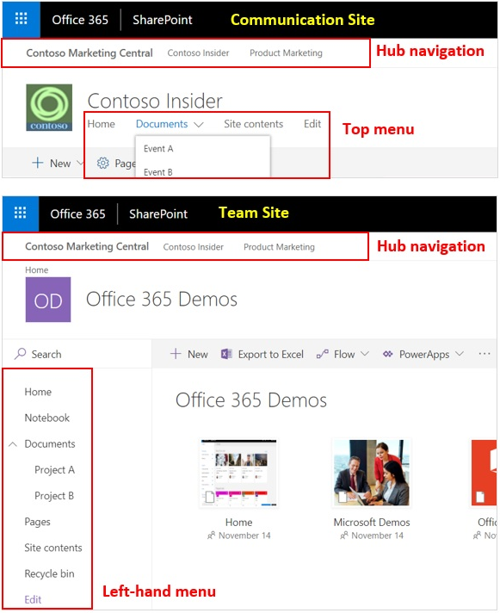
Overview of navigation in SharePoint
Hub navigation for groups of related sites
Hub site navigation is displayed above the local navigation on each site, just below the suite bar. Hub sites provide a great way to achieve the cross-site navigation features previously available in managed navigation and site hierarchies in classic SharePoint.

Slide 19
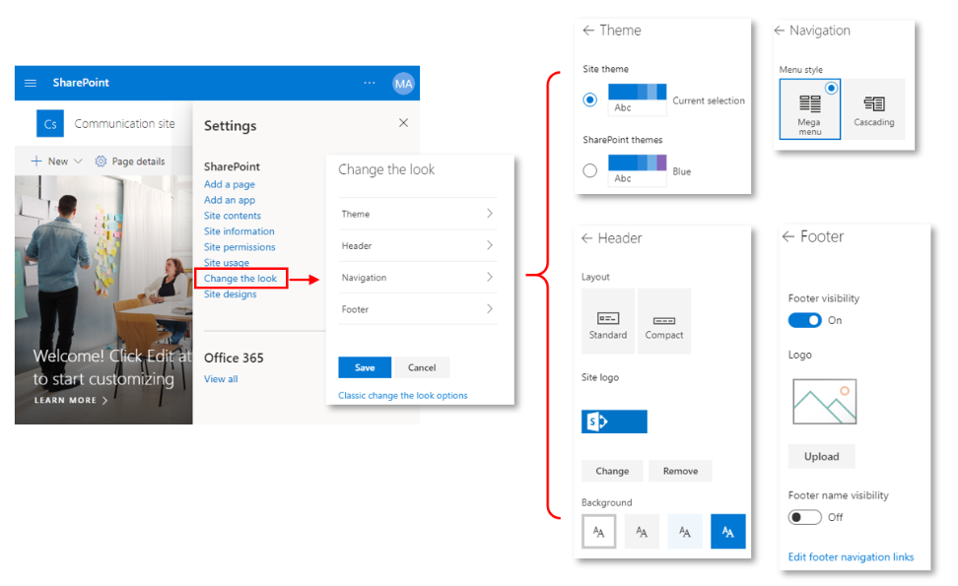
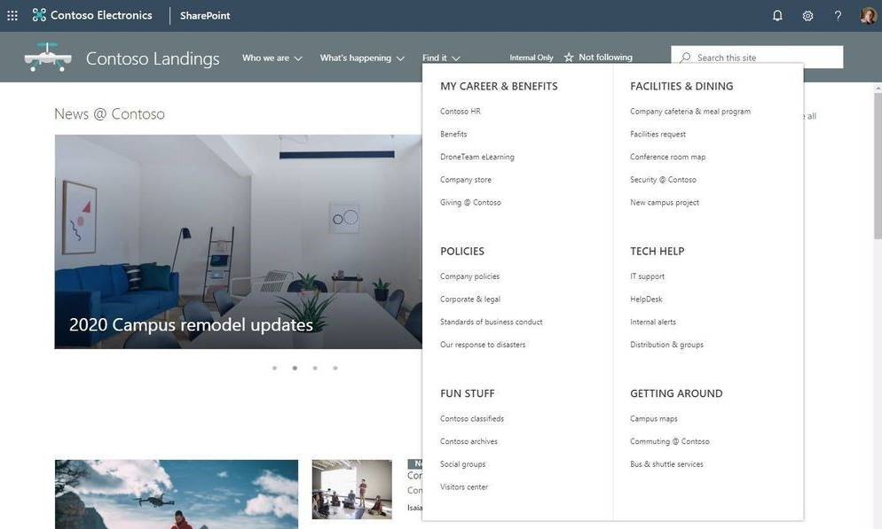
Overview of navigation in SharePoint
Megamenu navigation
Megamenu navigation is a feature in “Change the look” options. It allows showing multiple levels of hierarchy at once. This will enable you to better organize and showcase the content and sites. The megamenu navigation layout is only available for horizontally oriented navigations and allows for a panel display of links up to three levels.

Slide 20
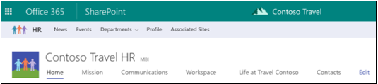
Overview of SharePoint hub sites
SharePoint hub sites provide the flexibility and help organizations by connecting and organizing sites based on project, department, division, region, etc.
Benefits of SharePoint hub sites
Shared navigation
Search across the hub
A home destination for the hub
News roll-up
Associated sites
Highlighted content

Slide 21
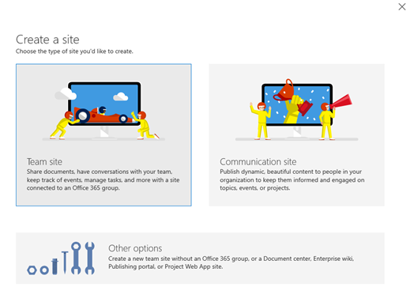
Create SharePoint sites
Microsoft 365 global admins and SharePoint admins can create SharePoint sites with different site templates. It is recommended to use modern SharePoint sites for new sites.
Create from the SharePoint admin center
Create from PowerShell
New-SPOSite
-Url https://contoso.sharepoint.com/sites/accounting
-Owner admin@contoso.com
-Template STS#3 //Team Site
-StorageQuota 100
-ResourceQuota 50
New-SPOSite
-Url https://contoso.sharepoint.com/sites/accounting1
-Owner $SiteOwner
-Template "SITEPAGEPUBLISHING#0" //Communication Site
-StorageQuota 2048
-Title $SiteTitle

Slide 22
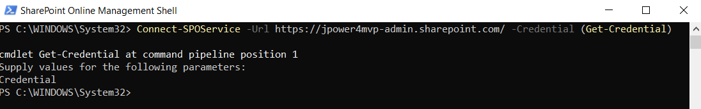
Create SharePoint Communication site
#Define Parameters
$AdminCenterURL = "https://tennant-admin.sharepoint.com/"
$SiteURL = "https://tennant.sharepoint.com/sites/communicationssite"
$SiteTitle = "My Communication Site"
$SiteOwner = "jenkinsns@jpower4mvp.onmicrosoft.com"
#Connect to SharePoint Online
Connect-SPOService -Url $AdminCenterURL -Credential (Get-Credential)
#PowerShell to Create new communication site
New-SPOSite -Url $SiteURL -Owner $SiteOwner -Template "SITEPAGEPUBLISHING#0" -StorageQuota 2048 -Title $SiteTitle

Slide 23
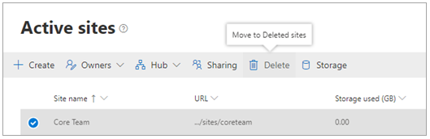
Delete SharePoint sites
Both global and SharePoint admins can delete both classic and modern sites, including sites that belong to Microsoft 365 groups. Deleting these sites will delete the group and all its resources, including the Outlook mailbox and calendar, and any Teams channels.
Delete a site
From the SharePoint admin center
From PowerShell
Permanently delete a site
From the SharePoint admin center
From PowerShell
Remove-SPOSite -Identity https://contoso.sharepoint.com/sites/site1
Remove-SPODeletedSite -Identity https://contoso.sharepoint.com/sites/sitetoremove

Slide 24

Restore SharePoint sites
Deleted site collections are automatically emptied from the site collection Recycle Bin after 93 days. You can restore a deleted site collection before this time.
Restoring a site that belongs to an Microsoft 365 Group restores the Microsoft 365 Group and all its resources. Note that the other group resources are retained for only 30 days, whereas the site is retained for 93.
Restore a site
From the SharePoint admin center
From PowerShell
Restore deleted items from the Recycle Bin
Restore-SPODeletedSite -Identity https://contoso.sharepoint.com/sites/arecycledsite

Slide 25
Where we come from
IT
Lists
HR
Libraries
Pages
Project 1
Project 2
Project 3
Policies
Benefits
Lists
Project 4
Project 5
Libraries
Pages
Site Collection
Sub Sites

Slide 26
Where we are – Modern Experience
Modern Sites are ‘Site Collections’
Always better when they are connected
Companies are made up of smaller groups and teams
Customers want to organize sites into grouping that
Make it easier for users to discover and recall related content
Apply common controls, branding and polices.
Search together and group common news and contents.
No more deep site structures
Modern Site is a “Flat Architecture”
Hubs connect related sites
Sales Report
Site Collections
Yearly Report
News
Sales
Customer Report
Regional sales
Expense Tracker
Feedback
Benefits
Travel Policies
Record Center
HR
Guidance
New Hires

Slide 27
Why do we need SharePoint Hub Sites
A dynamic, ever-changing digital workplace
We want to see things that are relevant
Navigate consistently and easily
Search in the context of where we are
Anyone can post news, comment or like items and read other’s news and comments
Constantly Changing Organisations
As administrators we need quick ways to restructure our sites
We need to be able to provision quickly as new requirements arrive
Customers always looking for a solution immediately.

Slide 28
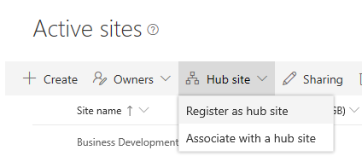
Configure SharePoint hub sites
Phase 1: Create a new hub site
To create a hub site, a global admin or SharePoint admin essentially converts an existing SharePoint site to a hub site. It's recommended to select a communication site or a team site that uses the modern template.
Phase 2: Design the hub site
Once the hub site has been created, the hub site owner can start designing the hub site for applying common navigation and branding across all associated sites.
Phase 3: Associates/Disassociate a site with a hub site
Once the hub site been created and configured, we can associates/disassociate sites with the hub site. There are three ways to associates/disassociate a site with a hub site

Slide 29
Configure SharePoint hub sites
Phase 4: Remove a site's hub site status
If you are a global admin or SharePoint admin in Microsoft 365, you can demote a hub site (remove its hub site status) by using PowerShell. Make sure you do this before you delete the hub site. When you demote a hub site, any sites still associated with the hub site will be automatically disassociated.
cmdlet | Description
Add-SPOHubSiteAssociation | Adds a new association between a site and a hub site.
Remove-SPOHubSiteAssociation | Removes an association between a site and a hub site.
Get-SPOHubSite | Lists hub sites or hub site information.
Grant-SPOHubSiteRights | Grants rights to users or security groups to access the hub site.
Register-SPOHubSite | Enables the hub site feature on a site to make it a hub site.
Revoke-SPOHubSiteRights | Revokes rights for specified principals to a hub site.
Set-SPOHubSite | Sets the hub site information such as name, logo, and description.
Unregister-SPOHubSite | Disables the hub site feature on a site.
The following PowerShell cmdlets are available for managing hub sites

Slide 30
Demo – Creating a Hub Site
Step 1: Create a Communication Site or Team Site
Step 2: Register the site as a Hub Site
To Register Hub Site we need admin permission, only administrator can register the site as Hub site using PowerShell
Use SharePoint Online PowerShell Console, download the Latest version.
To Connect the admin site
PS C:\Windows\system32> connect-SPOService -Url https://tenant-admin.sharepoint.com
PS C:\Windows\system32> Register-SPOHubSite –Site https://tenant.sharepoint.com/sites/hubsitename
To grant permission while registering hubsites
Register-SPOHubSite -Site https://tenant.sharepoint.com/sites/hubsitename -Principals ‘user@domain.com’

Slide 31
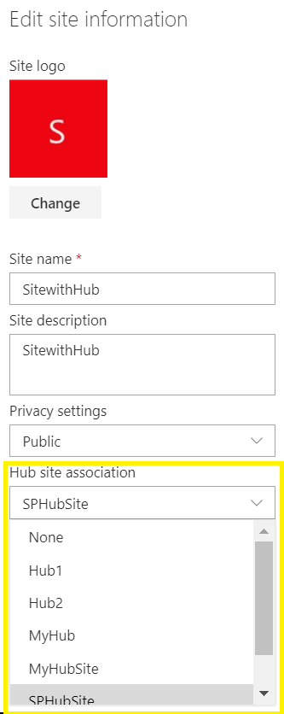
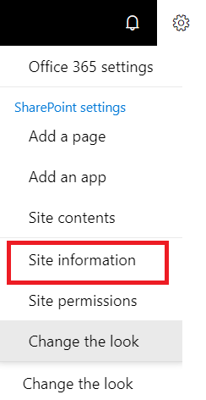
Demo – Associate sites with Hub sites
Step 1: Create a Communication or Team Site
Step 2: Click the cog and the select ‘Site information’
Step 3: Select the Hub Site to associate with.
Step 1: Connect the Admin site
PS C:\Windows\system32> connect-SPOService -Url
https://tenant-admin.sharepoint.com
Step 2: Associate the site with Hub
PS C:\Windows\system32> Add-SPOHubSiteAssociation https://tenant.sharepoint.com/sites/projects -HubSite https://tenant.sharepoint.com/sites/hubsite

Slide 32
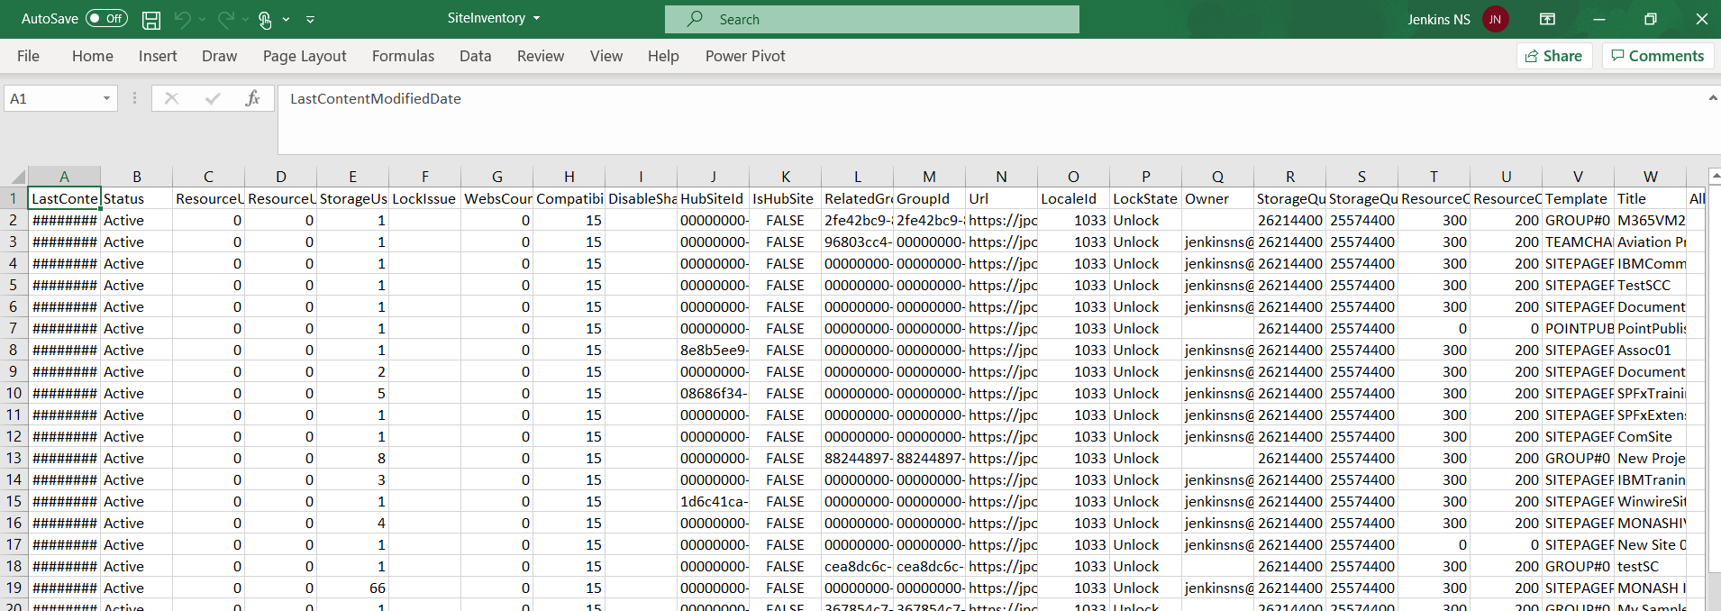
App Studio
What Sites Do I Have?
Inventory all Site Collections and output results to a CSV file using Get-SPOSite
Get-SPOSite | Export-CSV -LiteralPath c:\jenkins\SiteInventory.csv -NoTypeInformation
Import-CSV -LiteralPath c:\jenkins\SiteInventory.csv |
ForEach-Object {
Notes:
Import-CSV -LiteralPath c:\jenkins\SiteInventory.csv |
ForEach-Object {
$varTitle = $_.Title
$varUrl = $_.Url
$varOwner = $_.Owner
Write-Host "Site " $varTitle " creating"
New-SPOSite -Url $varUrl -Owner $varOwner -Template "SITEPAGEPUBLISHING#0" -StorageQuota 2048 -Title $varTitle
}

Slide 33
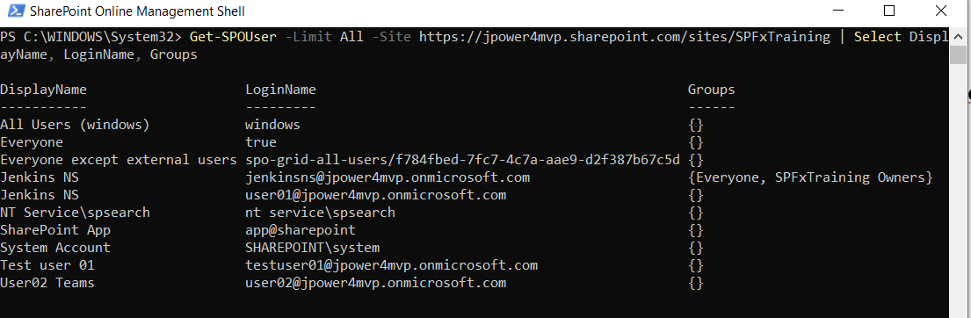
App Studio
Who Has Access?
List the SharePoint Groups that each user is a member of within a Site Collection using Get-SPOUser
Get-SPOUser -Limit All -Site https://jpower4mvp.sharepoint.com/sites/SPFxTraining | Select DisplayName, LoginName, Groups

Slide 34
App Studio
Configuring External Access
Configure the External Sharing Capability for a specific Site Collection
Use Set-SPOSite with the SharingCapability parameter, options:
Disabled
ExternalUserAndGuestSharing
ExternalUserSharingOnly
Set-SPOSite -Identity https://jpower4mvp.sharepoint.com/sites/testSC -SharingCapability Disabled

Slide 35
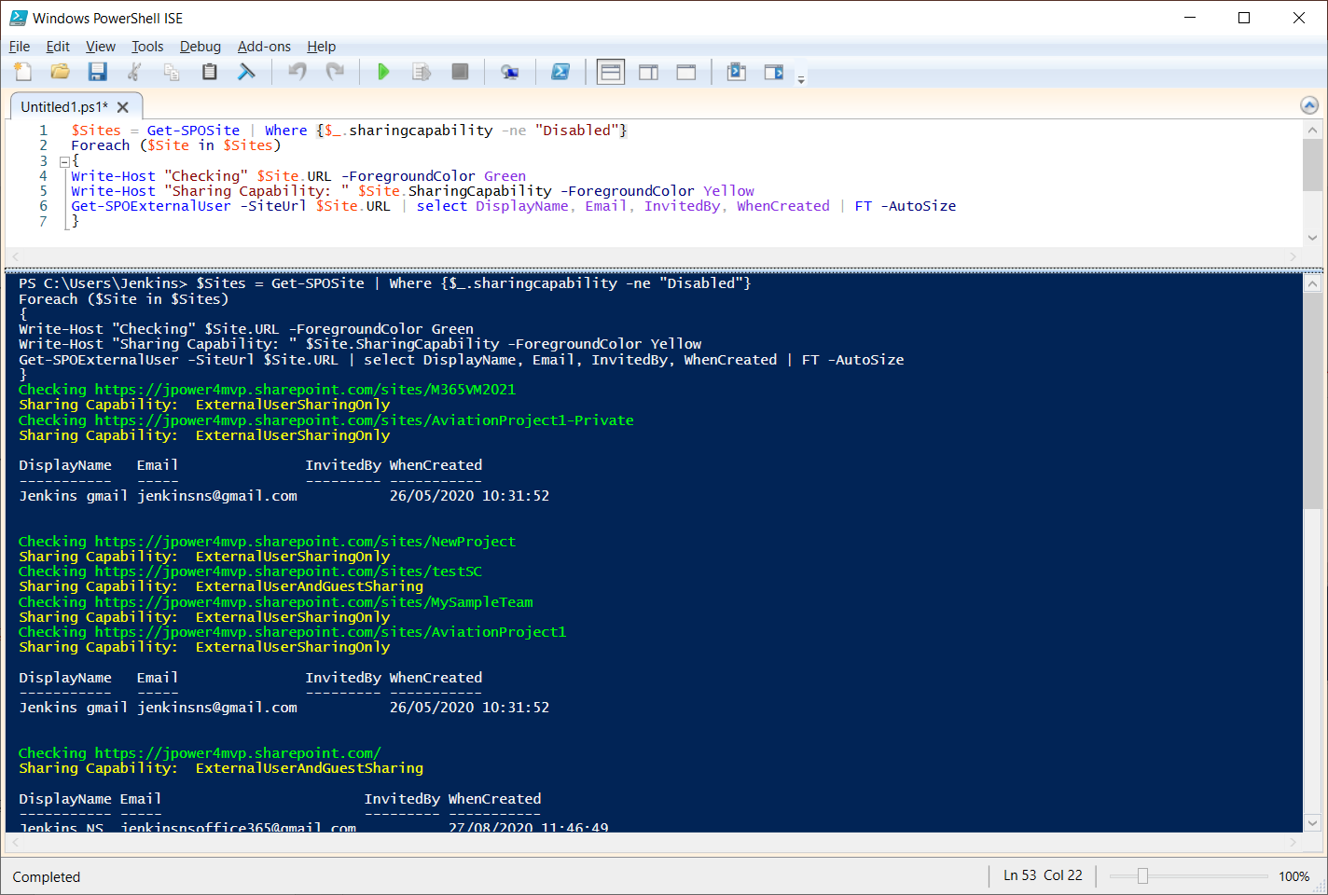
App Studio
Auditing External Access
Who has access? Where do they have access? Who invited them?
$Sites = Get-SPOSite | Where {$_.sharingcapability -ne "Disabled"}
Foreach ($Site in $Sites)
{
Write-Host "Checking" $Site.URL -ForegroundColor Green
Write-Host "Sharing Capability: " $Site.SharingCapability -ForegroundColor Yellow
Get-SPOExternalUser -SiteUrl $Site.URL | select DisplayName, Email, InvitedBy, WhenCreated | FT -AutoSize
}
Notes:
OR
$Sites = Get-SPOSite | Where {$_.sharingcapability -eq "Disabled" -or $_.sharingcapability -eq "ExternalUserAndGuestSharing"}
Foreach ($Site in $Sites)
{
Write-Host "Checking" $Site.URL -ForegroundColor Green
Write-Host "Sharing Capability: " $Site.SharingCapability -ForegroundColor Yellow
Get-SPOExternalUser -SiteUrl $Site.URL | select DisplayName, Email, InvitedBy, WhenCreated | FT -AutoSize
}
AND
$Sites = Get-SPOSite | Where {$_.sharingcapability -ne "Disabled" -and $_.sharingcapability -eq "ExternalUserAndGuestSharing"}
Foreach ($Site in $Sites)
{
Write-Host "Checking" $Site.URL -ForegroundColor Green
Write-Host "Sharing Capability: " $Site.SharingCapability -ForegroundColor Yellow
Get-SPOExternalUser -SiteUrl $Site.URL | select DisplayName, Email, InvitedBy, WhenCreated | FT -AutoSize
}

Slide 36
App Studio
Site Level Administration
Set-SPOSite can be used to:
Change Site Owner
Change the Title
Lock a Site - NoAccess, ReadOnly and Unlock
$URL = "https://jpower4mvp.sharepoint.com/sites/testSC"
Set-SPOSite -Identity $URL -Owner "User01@jpower4mvp.onmicrosoft.com"
Set-SPOSite -Identity $URL -Title "Hello Title"
Set-SPOSite -Identity $URL -LockState NoAccess
https://docs.microsoft.com/en-us/powershell/module/sharepoint-online/set-sposite?view=sharepoint-ps

Slide 37
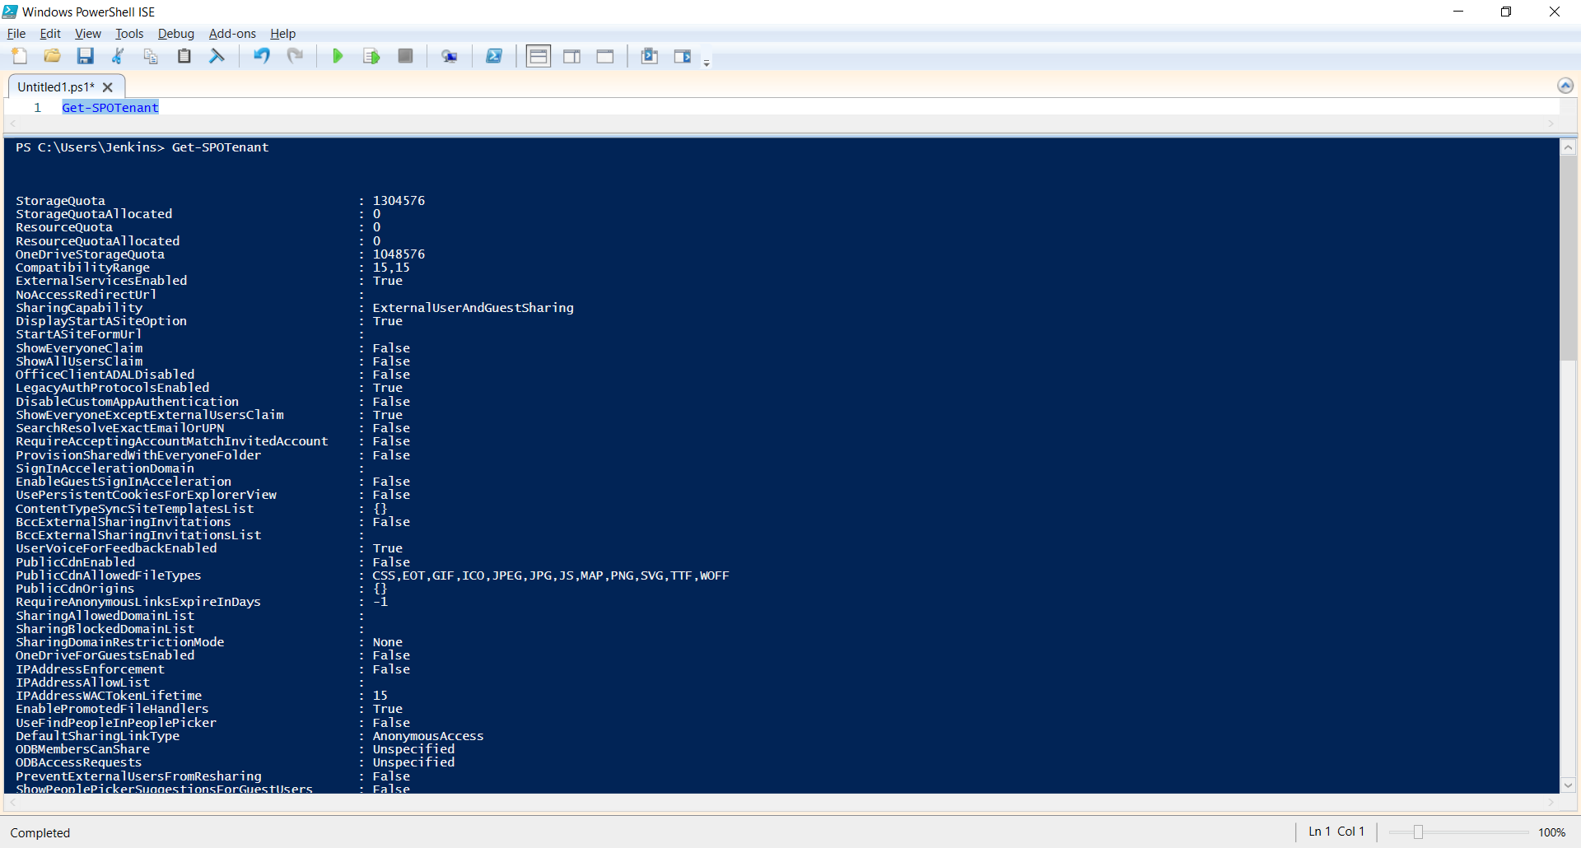
App Studio
Tenant Level Settings
Get/Set-SPOTenant can be used to retrieve and update Tenant level settings
Get-SPOTenant

Slide 38
SharePoint site theming
Theming experience components:
Color palette
Master page preview
Font scheme
Composed look
Background image
Change the look
Master page
Design gallery
Notes:
Explain SharePoint site theming.

Slide 39
Site design and site scripts
Use site designs and site scripts to automate provisioning new or existing modern SharePoint sites that use your own custom configurations:
Site designs
Site script
Use PowerShell or REST to work with site designs and site scripts
Scoping
Notes:
Explain Site design and site scripts.

Slide 40
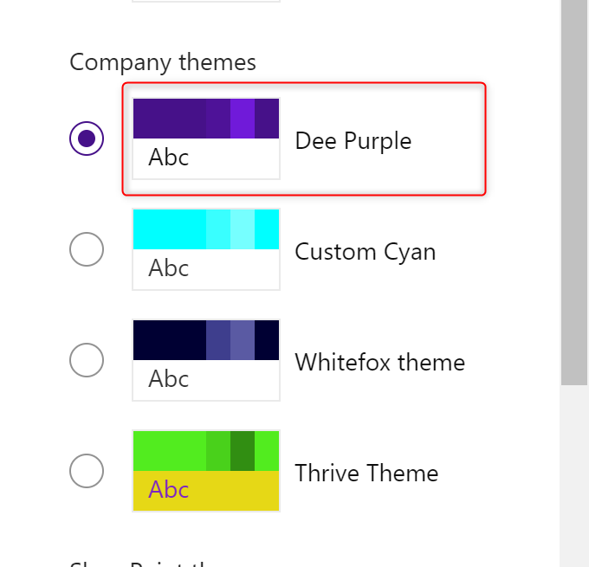
Site design and site scripts
Notes:
Explain Site design and site scripts.
Site Design GitHub Examples
https://github.com/SharePoint/sp-dev-site-scripts
$id = (Add-SPOSiteScript -Title "ApplyTheme" -Content $site_script1 -Description "MMC Demo Theme").ID
Add-SPOSiteDesign -Title "MMC Template Demo" -WebTemplate "64" -SiteScripts $id -Description "MMC Demo Template"

Slide 41
App Studio
SPO PowerShell - How Does this All Work?
SharePoint Online Management Shell is great for basic Site Collection and User administration
Example Get-SPOSite
Connects to the client.svc WCF service
Sends a request as XML
Response is returned as JSON
https://docs.microsoft.com/en-us/powershell/module/sharepoint-online/set-sposite?view=sharepoint-ps

Slide 42
Client-Side Object Model
PowerShell

Slide 43
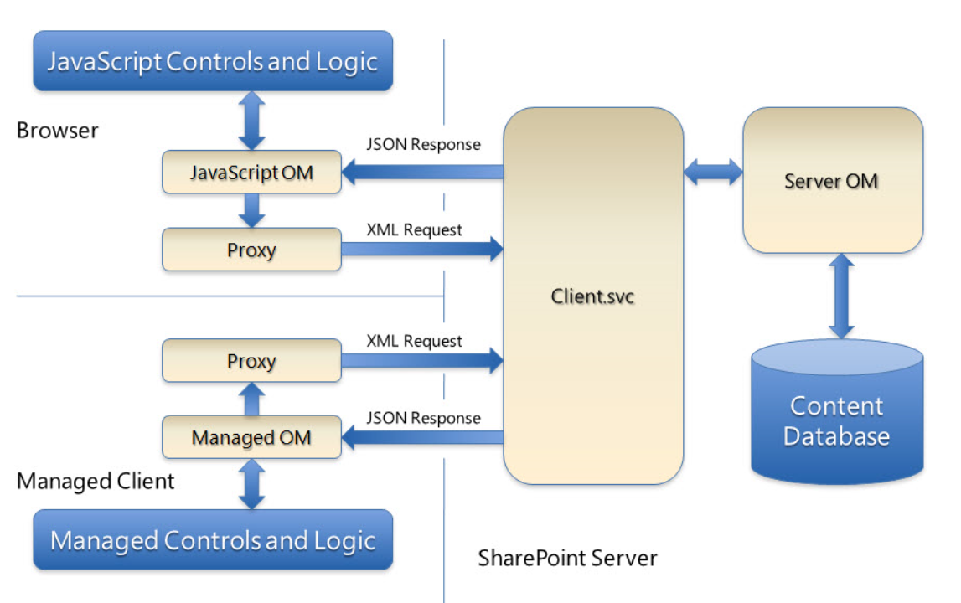
App Studio
CSOM – Client-Side Object Model
The Client-Side Object Model was introduced in SharePoint 2010 and is available in SharePoint Online
Provides a subset of the Server Object Model - can be executed remotely using JavaScript or .NET (PowerShell in this case)

Slide 44
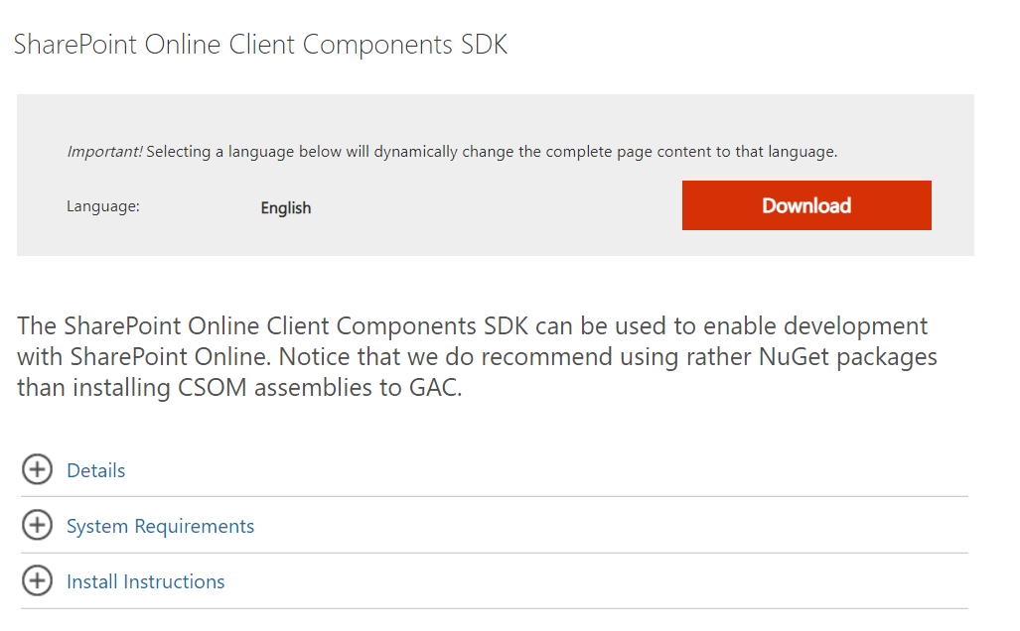
App Studio
Getting Started with CSOM
Download the SharePoint Online Client Components SDK here
Includes the DLLs required for CSOM
Fire up PowerShell and away we go
Once installed, It creates assembly (DLL) files in 16 hive on your computer at C:\Program Files\Common Files\Microsoft Shared\Web Server Extensions\16\ISAPI\
Download SharePoint Online Client Components SDK from Official Microsoft Download Center

Slide 45
App Studio
Why CSOM?
SharePoint Online Management Shell provides a number of PowerShell Cmdlets to manage SharePoint Online, it is quite limiting and the only way to do real SharePoint PowerShell is using the SharePoint CSOM. The Client-Side Object Model is a subset of the Server Object Model and can be used to supplement.

Slide 46
App Studio
How to write a CSOM PowerShell Script for SharePoint Online?
In SharePoint On-Premises, We had to log in to the SharePoint Server and write-execute PowerShell scripts. As SharePoint Online is in the cloud, we have the ability now to write and run PowerShell scripts remotely from our client machines. Here is the typical flow of CSOM PowerShell scripts:
Step 1: Add the SharePoint Online CSOM assembly references
Step 2: Initialize variables or command line parameters (optional)
Step 3: Create the Client Context
Step 4: Load objects into variables
Step 5: Retrieve properties or Call methods of the Objects

Slide 47
App Studio
Step 1: Add the SharePoint Online CSOM assembly references
As a first step, you need to load the CSOM libraries in the PowerShell script.
Add-Type -Path "C:\Program Files\Common Files\Microsoft Shared\Web Server Extensions\16\ISAPI\Microsoft.SharePoint.Client.dll"
Add-Type -Path "C:\Program Files\Common Files\Microsoft Shared\Web Server Extensions\16\ISAPI\Microsoft.SharePoint.Client.Runtime.dll"
While these two lines in the script are enough for most of the operations, we need to reference below DLLs, when we deal with service applications like user profiles, search, managed metadata, etc.
User Profile – Microsoft.SharePoint.Client.UserProfiles.dll
Managed Metadata – Microsoft.SharePoint.Client.Taxonomy.dll
Search – Microsoft.SharePoint.Client.Search.dll
Workflow – Microsoft.SharePoint.Client.WorkflowServices.dll

Slide 48
App Studio
Step 2: Initialize variables or command line parameters (optional)
You want to connect to a site and get the site name! We need to tell the PowerShell script, which site we need to connect and retrieve its property, isn’t it? This step is completely optional; however, it helps to simplify the script.
#Set Parameters
$siteURL = "https://jenkinsnsmmc.sharepoint.com/sites/MMCTrainingTeamSite"
$userId = "admin@jenkinsnsmmc.onmicrosoft.com"
$pwd = Read-Host -Prompt "Enter password" -AsSecureString

Slide 49
App Studio
Step 3: Create the Client Context
You need valid credentials to connect to the SharePoint Online site. You may want to get the username and password to connect at the runtime, or you can hard-code the credentials in the script itself!
$creds = New-Object Microsoft.SharePoint.Client.SharePointOnlineCredentials($userId, $pwd)
$ctx = New-Object Microsoft.SharePoint.Client.ClientContext($siteURL)
$ctx.credentials = $creds

Slide 50
App Studio
Step 4: Load objects into variables
Once you established the context, the next step is to load objects into variables. Say, you want to connect to a site and get the list Items. We need to load the lists object first!
$lists = $ctx.web.Lists
$list = $lists.GetByTitle(“ListName")
$listItems = $list.GetItems([Microsoft.SharePoint.Client.CamlQuery]::CreateAllItemsQuery())
$ctx.load($listItems)
$ctx.executeQuery()

Slide 51
App Studio
Step 5: Retrieve properties or Call methods of the Objects
Once we loaded the object, we can access its members either to retrieve its properties or call its methods to perform some operations.
foreach($listItem in $listItems)
{
Write-Host "ID - " $listItem["ID"] "Title - " $listItem["Title"]
}

Slide 52
App Studio
get List Items Example
Add-Type -Path "C:\Program Files\Common Files\Microsoft Shared\Web Server Extensions\16\ISAPI\Microsoft.SharePoint.Client.dll"
Add-Type -Path "C:\Program Files\Common Files\Microsoft Shared\Web Server Extensions\16\ISAPI\Microsoft.SharePoint.Client.Runtime.dll"
Add-Type -Path "C:\Program Files\WindowsPowerShell\Modules\SharePointPnPPowerShellOnline\3.7.1903.0\OfficeDevPnP.Core.dll"
$siteURL = "https://jenkinsnsmmc.sharepoint.com/sites/MMCTrainingTeamSite"
#$userId = "admin@jenkinsnsmmc.onmicrosoft.com"
#$pwd = Read-Host -Prompt "Enter password" -AsSecureString
#$creds = New-Object Microsoft.SharePoint.Client.SharePointOnlineCredentials($userId, $pwd)
#$ctx = New-Object Microsoft.SharePoint.Client.ClientContext($siteURL)
#$ctx.credentials = $creds
#MFA Install-Module -Name SharePointPnPPowerShellOnline -RequiredVersion 3.7.1903.0
$Authenticationmanager = New-Object OfficeDevPnP.Core.AuthenticationManager
$ctx = $Authenticationmanager.GetWebLoginClientContext($siteURL)
try{
$ctx.Load($ctx.Web)
$ctx.executeQuery()
Write-Host $ctx.Web.Title
}
catch{
write-host "$($_.Exception.Message)" -foregroundcolor red
}
Notes:
Good reference for Lists Manipulation
https://www.c-sharpcorner.com/article/list-item-operations-using-csom-with-powershell-for-sharepoi/
https://www.sharepointdiary.com/2014/08/sharepoint-online-add-new-list-item-using-csom-powershell.html

Slide 53
PnP PowerShell

Slide 54
App Studio
PnP PowerShell
PnP PowerShell is a cross-platform PowerShell Module providing over 500 cmdlets that work with Microsoft 365 environments and more specifically SharePoint Online, Microsoft Teams, Microsoft Planner and Microsoft Flow.
SharePoint Patterns and Practices (PnP) for SharePoint Online is a set of PowerShell cmdlets written by the community to efficiently manage SharePoint Online. PnP PowerShell internally uses the Client-Side Object model code for its operations. With PnP PowerShell, we can reduce the number of lines in our scripts by utilizing its built-in cmdlets and reduce the complexity of scripting implementations.

Slide 55
App Studio
What do we need?
PnP PowerShell
Getting up and running SharePoint Admin role
Install-Module -Name PnP.PowerShell
Install-Module SharePointPnPPowerShellOnline (old SharePoint pnp module)
Uninstall a Module
Uninstall-Module -Name SharePointPnPPowerShellOnline
Get-InstalledModule
Get-InstalledModule | Select Name, HelpUri | Export-Csv -LiteralPath c:\jenkins\listofcommants.csv -NoTypeInformation
574 cmdlets

Slide 56
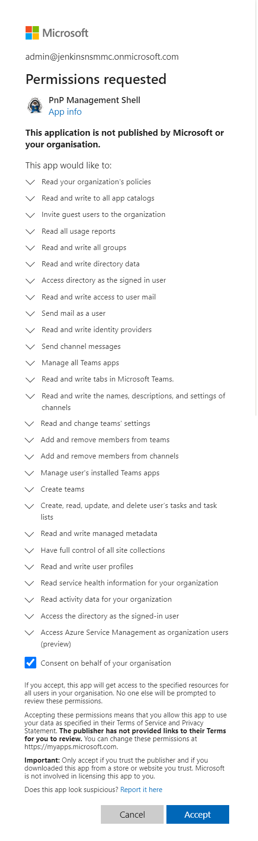
App Studio
First Time connect PnP Powershell
You have to connect with Connect-PnPOnline -Url <url> -PnPManagementShell and then you will receive a code to enter on https://microsoft.com/devicelogin , where you will need to login with credentials for an account that must have the Application Admin role assigned to them in the Admin Center, and then you can consent to give PnP Management Shell access to your tenant.
Connect-PnPOnline -Url https://jenkinsnsmmc.sharepoint.com/sites/MMCTrainingTeamSite -PnPManagementShell

Slide 57
App Studio
Connect SharePoint Online service
Connect SharePoint Online service
Connect-PnPOnline -Url "https://contoso.sharepoint.com"
Example:
Connect-PnPOnline -Url https://jenkinsnsmmc.sharepoint.com/sites/MMCTrainingTeamSite
Get-PnPListItem -List MyList
#For MFA
Connect-PnPOnline -Url "https://jenkinsnsmmc.sharepoint.com/sites/MMCTrainingTeamSite" -UseWebLogin

Slide 58
App Studio
Create New Modern Site
The New-PnPSite cmdlet creates a new site collection for the current tenant. Currently only 'modern' sites like Communication Site and the Modern Microsoft 365 group-connected team sites are supported. If you want to create a classic site, use New-PnPTenantSite.
To Create Communication Site
To Create Team Site
This will create a new Modern Team Site collection with the title 'New Team Site PnP' and the url 'https://jenkinsnsmmc.sharepoint.com/sites/NewTeamSitePnP' or 'https://jenkinsnsmmc.sharepoint.com/teams/NewTeamSitePnP' based on the managed path configuration in the SharePoint Online Admin portal and sets the site to public. (default private)
New-PnPSite -Type CommunicationSite -Title Contoso -Url https://jenkinsnsmmc.sharepoint.com/sites/newSitepnp
New-PnPSite -Type TeamSite -Title 'New Team Site PnP' -Alias NewTeamSitePnP -IsPublic

Slide 59
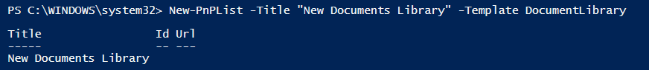
App Studio
NoListTemplate,
GenericList,
DocumentLibrary,
Survey, Links, Announcements, Contacts, Events, Tasks, DiscussionBoard, PictureLibrary, DataSources, WebTemplateCatalog, UserInformation, WebPartCatalog, ListTemplateCatalog, XMLForm, MasterPageCatalog, NoCodeWorkflows, WorkflowProcess, WebPageLibrary, CustomGrid, SolutionCatalog, NoCodePublic, ThemeCatalog, DesignCatalog, AppDataCatalog, AppFilesCatalog, DataConnectionLibrary, WorkflowHistory, GanttTasks, HelpLibrary, AccessRequest, PromotedLinks, TasksWithTimelineAndHierarchy, MaintenanceLogs, Meetings, Agenda, MeetingUser, Decision, MeetingObjective, TextBox, ThingsToBring, HomePageLibrary, Posts, Comments, Categories, Facility, Whereabouts, CallTrack, Circulation, Timecard, Holidays, IMEDic, ExternalList, MySiteDocumentLibrary, IssueTracking, AdminTasks, HealthRules, HealthReports, DeveloperSiteDraftApps, ContentCenterModelLibrary, ContentCenterPrimeLibrary, ContentCenterSampleLibrary, AccessApp, AlchemyMobileForm, AlchemyApprovalWorkflow, SharingLinks, HashtagStore, RecipesTable, FormulasTable, WebTemplateExtensionsList, ItemReferenceCollection, ItemReferenceReference, ItemReferenceReferenceCollection, InvalidType
Create New List or Library
Once the connection is established, you can start using PnP PowerShell cmdlets
New-PnPList -Title "New Documents Library" -Template DocumentLibrary
https://docs.microsoft.com/en-us/powershell/module/sharepoint-pnp/new-pnplist?view=sharepoint-ps

Slide 60
App Studio
Get Users
Get-PnPAzureADUser
Get-PnPAADUser -Identity admin@jenkinsnsmmc.onmicrosoft.com
Get-PnPUser
Get-PnPUser | ? Email -eq "admin@jenkinsnsmmc.onmicrosoft.com"

Slide 61
App Studio
Copy All Document Libraries to Another Site using PnP PowerShell
$SourceSiteURL = "https://jenkinsnsmmc.sharepoint.com/sites/Team01"
$DestinationSiteURL = " https://jenkinsnsmmc.sharepoint.com/sites/MMCTrainingComSite"
#Connect to the source Site
Connect-PnPOnline -URL $SourceSiteURL -UseWebLogin
#Get all document libraries
$SourceLibraries = Get-PnPList | Where {$_.BaseType -eq "DocumentLibrary" -and $_.Hidden -eq $False}
#Connect to the destination site
Connect-PnPOnline -URL $DestinationSiteURL -UseWebLogin
#Get All Lists in the Destination
$DestinationLibraries = Get-PnPList
ForEach($Library in $SourceLibraries)
{
#Check if the library already exists in target
If(!($DestinationLibraries.Title -contains $Library.Title))
{
#Create a document library
New-PnPList -Title $Library.Title -Template DocumentLibrary
Write-host "Document Library '$($Library.Title)' created successfully!" -f Green
}
else
{
Write-host "Document Library '$($Library.Title)' exists already!" -f Yellow
}
}

Slide 62
App Studio
Deploy And Install The SPFx App Using PNP PowerShell
SPFx is the new developmental model which is helpful in building add-ins for the SharePoint modern site. After developing our SPFx app, we have to bundle the app and move it to CDN or a source from where you want to serve your application.
There are two ways of deploying the app/add-ins, it is always important to understand before going on with the deployment.
Site Collection scoped SPFx apps
Tenant Scoped apps
#Add the SPFx App to the app catalog
Add-PnPApp -Path ./myapp.sppkg
#Add the SPFx App and Publish
Add-PnPApp -Path ./myapp.sppkg -Publish
#Add the SPFx App Scope Site collection
Add-PnPApp -Path ./myapp.sppkg -Scope Site –Publish
#To Overrite Existing installed app
Add-PnPApp -Path ./myapp.sppkg -Overwrite
Notes:
Add-PnPApp -Path C:\Jenkins\SPFx\MMCSPFXPowerShell\firstSPFx\sharepoint\solution\first-sp-fx.sppkg -Publish -SkipFeatureDeployment

Slide 63
App Studio
Q & A

